Slide 1
Phone Fraudsters in a Haystack
Sri Kanajan
1st place in NTT Machine Learning Hackathon
Poster Presentation in GraphLab Conference 2014
July 31st 2014

Slide 2

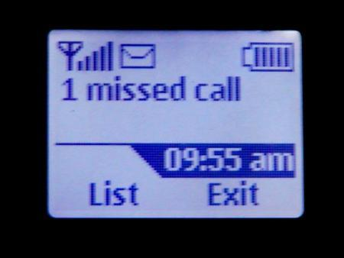

Example of Phone Fraud
Leaves International Missed Call
$2 BILLION OF LOST REVENUE FROM
TELCOM PROVIDERS
Unknowingly Calls Premium Number or
Manipulative Advertisement

Slide 3
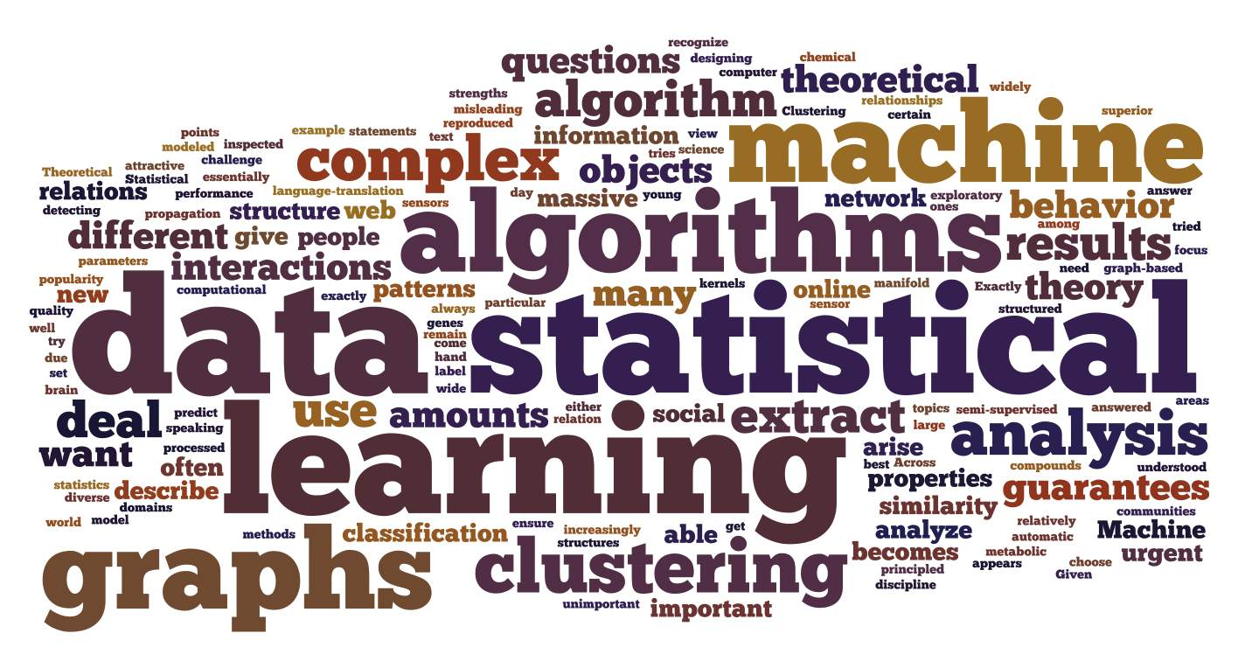
Motivations
Current statistical solutions have low specificity and sensitivity
Human fraud analysts have to continually update their heuristic based rules and thresholds
Need an adaptive solution that works in real time with minimal false positives

Slide 4
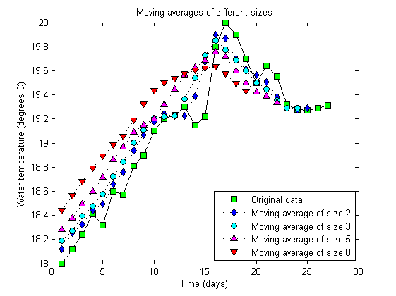
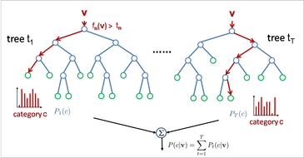
Hybrid Statistical and Machine Learning Solution
Statistical Analysis Anomaly Detection
Number of Callers/Callee/Cumulative Call Duration
Live Streaming Phone Data
Used Hackathon De-identified Phone Log Dataset 16 GB
Machine Learning
(Random Forests)
Evaluation of other features in the call log such as answer indicator, area code, pricing…

Slide 5
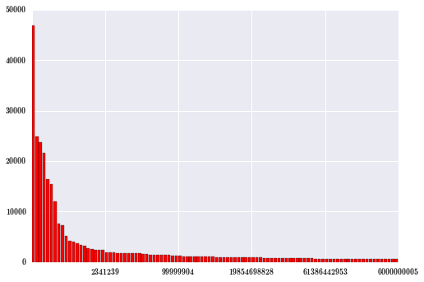
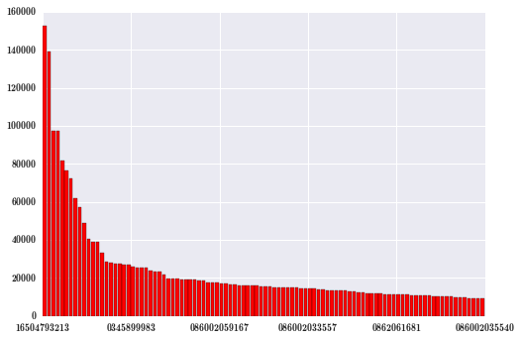
Anomaly Detection Through Statistical Analysis
# of Unique Caller’s per Phone Number
ANOMALOUS Phone Numbers!!
# of Unique Callee’s per Phone Number
Cumulative Duration of Calls to Specific Phone Numbers

Slide 6
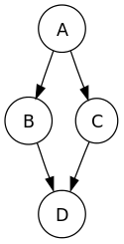
Hybrid Statistical and Machine Learning Solution
Statistical Analysis Anomaly Detection
Live Streaming Phone Data
Predicted
Anomalies
Graph Analysis Anomaly Detection
Machine Learning
(Random Forests)

Slide 7



Fraud Detection Using Graph Metrics
Triangle Counting
PageRank
Others… Note: Goal is to uncover the callers that are very different from the large majority

Slide 8
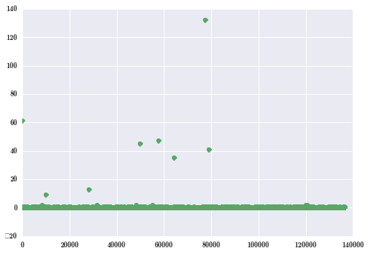
Fraud Detection Using Graph Metrics
Possible Fraudsters!
Using Principal Component Analysis to uncover the outliers in the graph metrics

Slide 9

Hybrid Statistical and Machine Learning Solution
Statistical Analysis Anomaly Detection
Live Streaming Phone Data
Predicted
Anomalies
Graph Analysis Anomaly Detection
Machine Learning
(Random Forests)
Possible Fraud
Human Observed Fraud Analyst

Slide 10
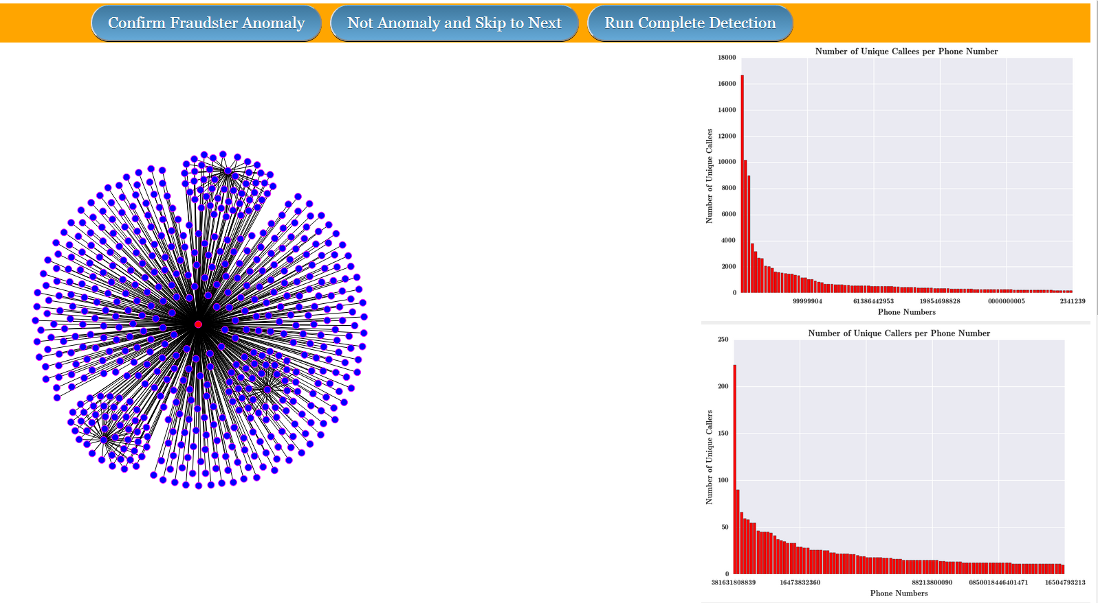
Fraud Detection Using Graph Metrics
Human Fraud Analyst Confirmation of Fraudster
www.fraud-detector.net

Slide 11
Hybrid Statistical and Machine Learning Solution
Statistical Analysis Anomaly Detection
Live Streaming Phone Data
Graph Analysis Anomaly Detection
Predicted
Anomalies
Machine Learning
(Random Forests)
Possible Fraud
Human Observed Fraud Analyst
Confirmed Fraudsters

Slide 12
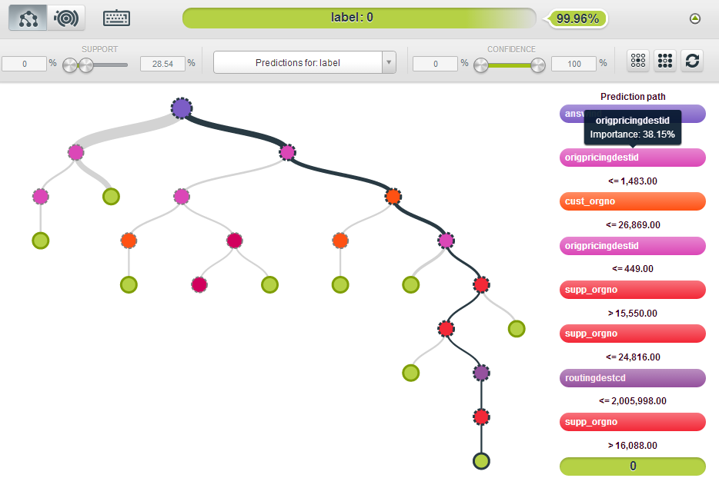
Machine Learning

Slide 13
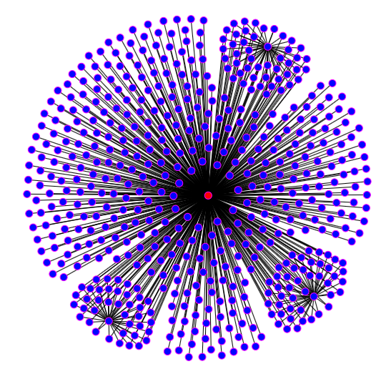
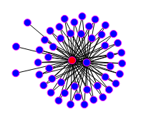
Conclusion
Possible False Positive
Possible Fraudster

Slide 14
Future Work
Increase scalability and real time performance by employing technologies such as Spark and Hadoop
Develop validation framework by encoding various fraud graphs and identifying performance of the system

Slide 15

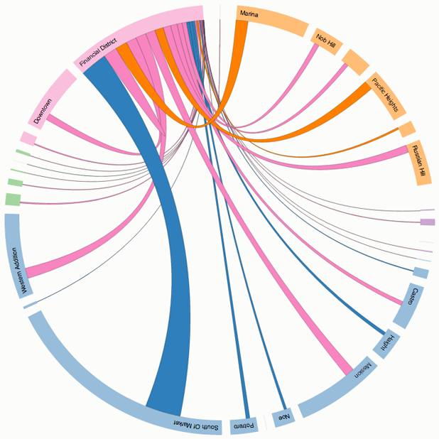





Acknowledgements
Argyle Data
Arshak Navruzyan, Nataliya Nadtoka
Zipfian Academy
All Zipfian Instructors !!!
Mijail Gomez, Prasad Telukuntla, Ethan Cheung
Technologies Used
Python
D3
Argyle Data
Arshak Navruzyan, Nataliya Nadtoka
Zipfian Academy
All Zipfian Instructors !!!
Mijail Gomez, Prasad Telukuntla
Technologies Used

